Slide 1

AIIT 2017
CAUSALITY LIBRARY FOR FORMAL SYSTEM
University of Novi Sad
Technical Faculty “Mihajlo Pupin”
Aleksandar Berar
dr Višnja Ognjenović
Prof. dr Ivana Berković
Zrenjanin, 2017

Slide 2
1. INTRODUCTION
In this paper a java library called Causaility (causality or causality) will be presented.
This name is chosen because the effect of the library resembles that term; the predetermined predicate chooses a subclass of a superclass which corresponds to the effect or consequence.
For example, if there is a superclass called Shape that is split into classes such as Triangle, Square, etc. then predicates can be defined from which it would follow the appropriate class selection.

Slide 3
1. INTRODUCTION
Java programming language is a compiled programming language. So if there is a need to make a change to the code, often the whole project must be re-compiled and artifacts must be installed again.
Because of this case and problem, this library was created. In this way, it is possible to isolate parts of the system that can be redefined by altering the textual information consisting of JSON textuality and defining predicates and selecting class implementations in a different way, thereby avoiding re-compiling the entire project.

Slide 4
2. MATHEMATICAL SETTING
A formal system or logical calculus is any well-defined system of abstract thought based on the model of mathematics. A formal system need not be mathematical as such.
Each formal system uses a set of primitive symbols (sometimes known as an alphabet) to finitely construct a formal language from a set of axioms through inferential rules of formation.
The system thus consists of valid formulas built up through finite combinations of the primitive symbols—combinations that are formed from the axioms in accordance with the stated rules.

Slide 5

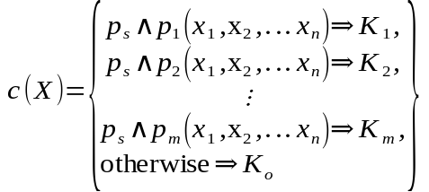




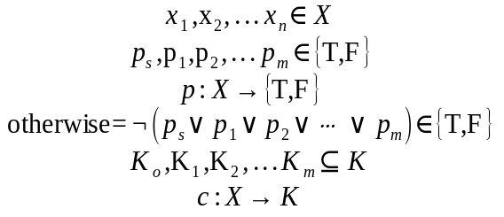



2. MATHEMATICAL SETTING
is the alphabet of arbitrary variables.
are elements of the alphabet, or symbols.
are predicate functions that translate the set of arbitrary variables into the set of truthfulness.
is the negation of disjuntion of all predicate functions.
is the superclass.
are the subclasses.
is a relation that represents "Km is a subtype of K".
is the super-cause.

Slide 6
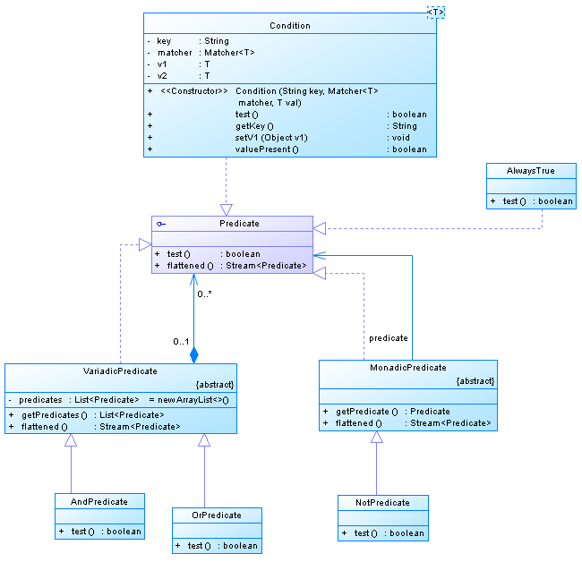
3. PREDICATE CLASSES
The bases of the predicate class packet is the Predicate interface, which consists of two methods: test and flattened. The test method is an important method that returns a boolean value for some predicate. Flattened method is a method that returns the stream of predicates since some predicate implementations contain multiple predicates.

Slide 7
3. PREDICATE CLASSES
{
"type": "cond",
"key": "b",
"matcher": {
"type": "string",
"impl": "equals"
},
"value": "tested"
}
Condition is a typed class that implements the Predicate interface and it's a bit more complicated than other classes that implement this interface. One field of this class is Matcher ie. a matching class that will be explained in the next chapter. It is important to note that the Matcher type corresponds to a type that defines a typed object of the Condition class. The objects of this class are practically used to compare the values of the key variables with some parameter over the matching Matcher class.

Slide 8
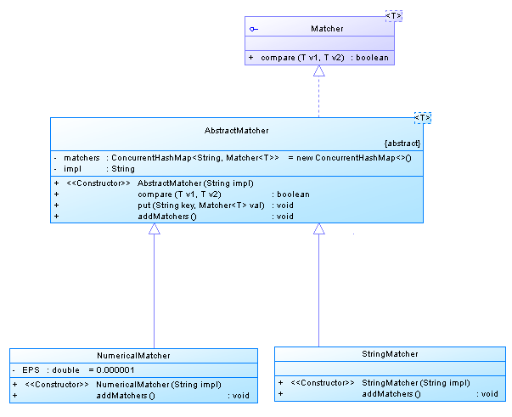
4. MATCHER CLASSES
Basically, the Matcher interface is a typed interface and the idea is that based on two input values that are of this type, it returns a boolean type as the output value.
Matcher interface implementation is an abstract typed AbstractMatcher class that contains a private field from an associative array matchers whose key is a String object that points to a Matcher of type T. This associative array will be filled by classes that inherit the AbstractMatcher class, these are the NumericalMatcher classes and StringMatcher.

Slide 9
4. MATCHER CLASSES
public class NumericalMatcher extends AbstractMatcher<Double> {
private static final double EPS = 0.000001;
@JsonCreator
public NumericalMatcher(@JsonProperty("impl") String impl) {
super(impl);
}
@Override
public void addMatchers() {
put(">", (v1, v2) -> v1 > v2);
put(">=", (v1, v2) -> v1 >= v2);
put("<", (v1, v2) -> v1 < v2);
put("<=", (v1, v2) -> v1 <= v2);
put("==", (v1, v2) -> Math.abs(v1 - v2) < EPS);
}
}
public class StringMatcher extends AbstractMatcher<String> {
@JsonCreator
public StringMatcher(@JsonProperty("impl") String impl) {
super(impl);
}
@Override
public void addMatchers() {
put("equals", ((v1, v2) -> v1.equals(v2)));
put("startsWith", ((v1, v2) -> v1.startsWith(v2)));
put("endsWith", ((v1, v2) -> v1.endsWith(v2)));
}
}

Slide 10
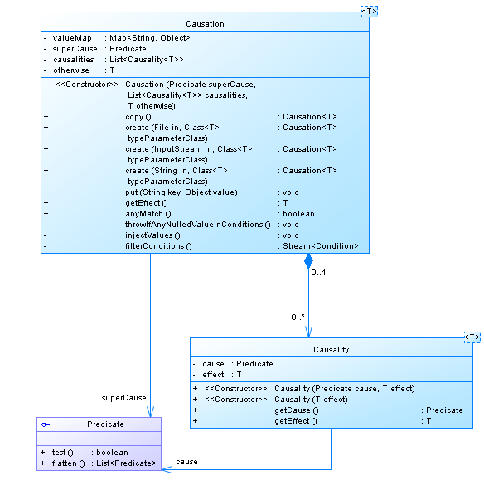
5. CAUSALITY CLASSES
Causation is a typified class that is the most important class in this library. Each Causation object consists of a superCause field that is of the Predicate type and this predicate corresponds to an over-condition that must always be fulfilled for the given problem. The next field is the causalities that is a list of Causality objects of type of T. The field otherwise is a field of type T and corresponds to the result or effect when no predicate from the predicate part within the causalities list is met.

Slide 11
5. CAUSALITY CLASSES
public T getEffect() {
injectValues();
throwIfAnyNulledValueInConditions();
if (!superCause.test())
return otherwise;
return causalities.stream().filter(c->c.getCause().test()).findFirst()
.orElse(new Causality<>(otherwise)).getEffect();
}
private void injectValues() {
superCause.flattened().flatMap(Predicate::flattened)
.filter(x-> x instanceof Condition).map(Condition.class::cast).forEach(c-> c.setV1(valueMap.get(c.getKey())));
filterConditions().forEach(c-> c.setV1(valueMap.get(c.getKey())));
}
It is important to note the valueMap field that is of type of associative array with the keys that are String objects and values that are Object objects themselves. Within this field, the values of the variables will be found. For example, we can have some variable "a" and then it is the key within this associative array, and the value for that variable or that key will be in the value for that key in an associative set depending on the current state of the program.

Slide 12
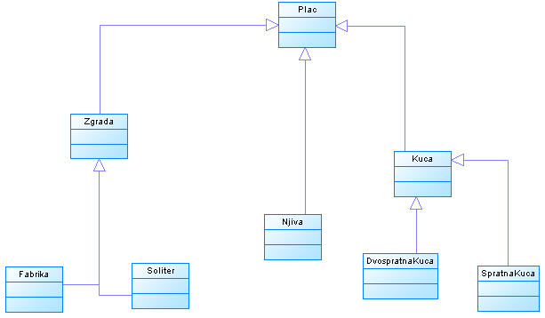
6. EXAMPLE PROGRAM
An easy-to-use java program was developed as an example of the utilization of the library. Several model classes will be constructed that will inherit from the Plac (Land) class and will represent residential, commercial or agricultural facilities. There will be some arbitrary variables that will be used to select the appropriate class from the class model.

Slide 13
6. EXAMPLE PROGRAM
The arbitrary variables that will be considered are the area, number of rooms and number of floors. Over these random variables, certain predicates will be set up using the JSON format and the Causality library. The effects of the Causality object will be String objects, which will then be passed to the static method create of the Plac class that uses the Factory pattern, which, based on the passed String object, selects the correct class that is a Plac or a subclass of the Plac class.
The first level of selection corresponds to the search for an effect that can be a class of Plac, or type of Building, or type of Field or House type. If the effect of the first level is the type of Building or House type, the program will further bend to the next selection through newly defined rules from some other Causation data.

Slide 14
6. EXAMPLE PROGRAM
{
"superCause": {
"type": "alwaysTrue"
},
"causalities": [
{
"cause": {
"type": "cond",
"key": "brojSpratova",
"matcher": {
"type": "numerical",
"impl": "=="
},
"value": 1.0
},
"effect": "spratnakuca"
},{
"cause": {
"type": "cond",
"key": "brojSpratova",
"matcher": {
"type": "numerical",
"impl": "=="
},
"value": 2.0
},
"effect": "dvospratnakuca"
}
],
"otherwise": "kuca"
}

Slide 15
6. EXAMPLE PROGRAM
if (p1 instanceof Kuca) {
Causation<String> causation2 = Causation.create(Main.class.getResourceAsStream("/c2.json"), String.class);
causation2.put("povrsina", povrsina);
causation2.put("brojSoba", brojSoba);
causation2.put("brojSpratova", brojSpratova);
Plac p2 = Plac.create(causation2.getEffect());
}
If the type of object p1 is House, this part of the code is executed. First, the c2.json data is read and parsed as a Causation object typed over the String class. After that, this Causation object, causation2, sets values within its valueMap object with the forwarded arguments in the program. Finally, you can get the effect of the String object type, which is passed to the factory method from the Plac class, and this gives an object that can be a type of House, SpratnaKuca or DvospratnaKuca.

Slide 16
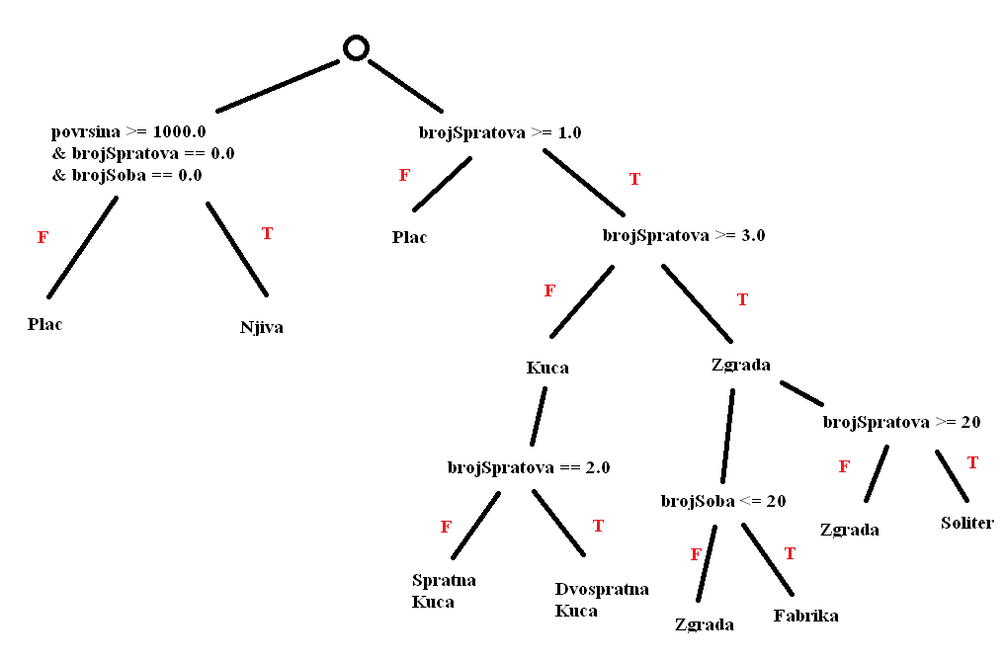
6. EXAMPLE PROGRAM

Slide 17
7. CONCLUSION
In this paper a Java library called Causaility (causality or causality) was introduced. This name is chosen because the effect of the library resembles that term; the predetermined predicate chooses a subclass of an superclass which corresponds to the effect or consequence.
A formal system or logical account is a properly defined system of abstract thought based on a mathematical model. The mathematical settings for this library are also given in the chapter on mathematical settings.
Predicate classes are class implementations of Predicate interfaces and they represent the predicate abstraction. Matching classes are so-called "matcher" classes of a type T and they in some way compare two values of type T. The classes of causality are higher-class classes in the library that deal with the already mentioned classes and interfaces and serve for JSON parsing and selecting the right effects across predicates that compare arbitrary variables.

Slide 18
7. CONCLUSION
The preceding chapter presents an example of a program that uses this library to determine the type of land based on forwarded parameters. Since there are several levels of decision-making, there is a branching which is tabulated through several iterations.
Further improvements to the Causality library could relate to branching support with a single causality class, so that the Causation object could actually consist of several Causation objects and thus divide the effects within a single Causation object meaning that no more Causation objects should be used as shown in the example from the previous chapter.
It is also important to note that this library is dependent on another open-source library, fasterxml-jackson version 2.7.0, which is used to parse JSON text formats. The reason is that this library comes with its JSON parser that is used to determine the Causation object in a text format. Further improvement would be the writing of custom AST parser for a plain formal-predicate mathematical inscription that would contribute to greater readability.

Slide 19
THANK YOU
Contact: mailto:aleksandar.berar@gmail.com
Source code: https://github.com/berar/Causality
Released under Apache 2.0 license

